Slide 1
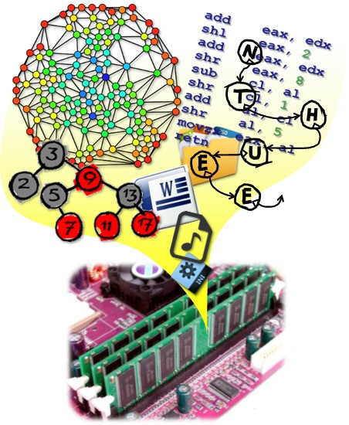
Data Structures
CH7 Sorting
Prof. Tai-Lang Jong
Office: Delta 928
Tel: 42577
email: tljong@mx.nthu.edu.tw
Spring 2021

Slide 2
Outline
7.1 Introduction
7.2 Insertion Sort
7.3 Quick Sort
7.4 How fast we can sort
7.5 Merge sort
7.6 Heap sort
7.7 Radix sort
7.8 (List and table sorts)
7.9 Summary of internal sorting

Slide 3
Important Uses of Sorting
Searching a List of records – a common operation
Each record has 1 or more fields
Record uses key fields to distinguish among records
Search for a record with the specified key
Sorting aids searching in a list
O(n) time for an unordered list (with sequential search)
O(log(n)) time for a sorted list (with binary search)
Sorting aids matching two lists
O(nm) time for unordered lists (with sequential search)
O(n+m) time for sorted lists

Slide 4
Sequential Search
template <class E, class K>
int SeqSearch(K *a, const int n, const K& k)
{ // search a[1:n] from left to right. Return least i
// such that the key of a[i] = k, return 0 if not
int i;
for (i = 1; i <= n && a[i] != k; i++);
if (i> n) return 0; // not found
return i; // found
}
If all keys are distinct and the key a[i] is being searched for, the i key comparisons are made
The average number of comparisons for a successful search is

Slide 5
Binary Search
template <class E, class K>
int BinarySearch(K *a, const int n, const K& k)
{ // search sorted a[1:n] for k
int left = 1, right = n;
while(left <= right){
int middle = (left+right)/2;
if(k < a[middle]) right = middle - 1;
else if(k > a[middle]) left = middle + 1;
else return middle; // found
}
return -1; // not found
}
The number of comparisons for unsuccessful search is

Slide 6
Verifying Two Lists
Comparing two lists of records containing data that are essentially the same but have been obtained from two different sources, e.g., employers filing their pays to employees (list l1) and employees filing their individual pays received (list l2).
Required verification:
If there is no record in the employee list (l2) corresponding to a key in the employer list (l1), a message is to be sent to the employee.
If the reverse is true, then a message is to be sent to the employer.
If there is a discrepancy between two records with the same key, a message to this effect is to be output.

Slide 7
Verifying Two Lists
Assume l1 is the employer list which contains n records and l2, employee list, m records
l1, l2 unsorted ⇒ Verify using sequential search
O(mn)
Sort l1, l2 first then verify ⇒ Fast verify
O(t_{sort}(n) + t_{sort}(m) + n+m)

Slide 8
Verifying 2 Lists w Sequential Search
void Verify1 (Element *l1, Element *l2, const int n, const int m)
{ // 比對兩個大小分別為n跟m的未排序過的串列l1與l2，。
bool *marked = new bool [m + 1];
fill (marked + 1, marked + m + 1, false); for (i = 1 ; i <= n ; i++)
{
int j = SeqSearch (l2, m, l1[i]);
if (j == 0) cout << l1[i] << “ not in l2 “ << endl; // 滿足 (1)
else
{
if (!Compare (l1[i], l2[j]) // 滿足 (3)
cout << “Discrepancy in “ << l1[i] << endl;
marked [j] = true; // 將l2[j]標為已檢查
}
}
for (i = 1; i <= m ; i ++)
if(!marked [i])cout << l2[i] << “ not in l1. “ << endl; // 滿足(2)
delete [] marked;
}

Slide 9
Fast Verifying 2 Lists
void Verify2 (Element *l1, Element *l2, const int n, const int m)
{ // 跟Verify1的工作一樣。不過，這次我們先對l1、l2排序過。 Sort(l1, n); // 依鍵值的遞增順序做排序
Sort(l2, m); int i = 1, j = 1;
while (( i <= n) && ( j <= m)) {
if ( l1[i] < l2[j]) { cout << l1[i] << “ not in l2” << endl; i++; }
else if (l1[i] > l2[j]) { cout << l2[j] << “not in l1” << endl; j++; }
else // 鍵值相等
{
if (!Compare (l1[i], l2[j])) cout << “Discrepancy in” << l1[i] << endl;
i++; j++;
}
}
if (i <= n) OutputRest(l1, i, n, 1); // 輸出l1從i到n的記錄
else if (j <= m) OutputRest(l2, j, m, 2); // 輸出l2從j到m的記錄
}

Slide 10
Classification of Sorting
Complexity
Time complexity
Space complexity
Stability
A sort is called stable iff it maintains the relative order of records with equal keys
Internal vs. external
An internal sort requires its inputs to be small enough so that the entire sort can be carried out in main memory
Examples: Selection Sort, Insertion Sort, Quick Sort, Heap Sort
An external sort has no abovementioned requirement
Score | Name
100 | Alice
90 | Bob
100 | David
90 | Emily
Score | Name
100 | Alice
100 | David
90 | Emily
90 | Bob
non-stable sort example

Slide 11
Internal Sort
Bubble sort – simple but slow
Priority queue sort
Sequence
Insertion sort
Selection sort
Heap
Heap sort
Quick sort – divide-and-conquer
Merge sort –divide-and-conquer, set ADT
Bucket sort
Radix sort

Slide 12
Outline
7.1 Introduction
7.2 Insertion Sort
7.3 Quick Sort
7.4 How fast we can sort
7.5 Merge sort
7.6 Heap sort
7.7 Radix sort
7.8 (List and table sorts)
7.9 Summary of internal sorting

Slide 13
Insertion Sort
The basic step in insertion sort is to insert a new record into a sorted sequence of i records in such a way that the resulting sequence of size (i + 1) is also ordered (sorted)
Priority Queue
a[ ]
sorted
1
i
a[ ]
sorted
1
i+1

Slide 14
Insertion Sort Concept
0
1
2
3
4
5
5
3
4
1
2
array[0] is used as temporary space
array[1] is the initial sorted sublist
Insertion pass
Place the element next to the sublist to the temporary space
Insert the element to the sublist
Insertion passes are continued until the sublist contains all records
Insertion Sort is a stable sort
3
5
4
1
2
3
5
4
1
2
4
3
5
1
2
3
4
5
1
2
1
3
4
5
2
1
3
4
5
2
2
1
3
4
5
1
2
3
4
5

Slide 15
Insertion Sort Algorithm
template <class T>
void InsertionSort(T *a, const int n)
{ // sort a[1:n] into nondecreasing order
for (int j = 2; j <= n ; j++){
a[0] = a[j];
for (int i = j - 1; a[i] > a[0]; i--)
{
a[i + 1] = a [i];
}
a[i + 1] = a[0];
}
}
Comparison
Data move
Data move
Need one extra space a[0]

Slide 16
How Fast is Insertion Sort?
5
3
4
1
2
Worst-case time complexity
When input is in a reversed order
Each insertion pass involves i comparisons, i = 1..n
1+2+…+n = O(n²)
Average time complexity
It has been shown that Insertion Sort is O(n²) on average
3
5
4
1
2
3
5
4
1
2
4
3
5
1
2
3
4
5
1
2
1
3
4
5
2
1
3
4
5
2
2
1
3
4
5
1
2
3
4
5

Slide 17
Insertion Sort Algorithm
template <class T>
void Insert(const T& e, T* a, const int i)
{ // insert e into ordered a[1:i]
a[0] = e;
while(e < a[i])
{
a[i + 1] = a[i];
i--;
}
a[i + 1] = e;
}
Insert makes i+1 comparisons so complexity is O(i)

Slide 18
Insertion Sort
template <class T>
void InsertionSort(T* a, const int n)
{ // Sort a[1:n] into nondecreasing order
for(int j = 2; j<=n;j++)
{
T temp = a[j];
insert(temp, a, j-1);
}
}
InsertionSort invokes Insert() for i = j-1 = 1,2,…,n-1, so the complexity of InsertionSort is

Slide 19
Relative Disorder
Left out of order (LOO):
Record R_{i} is LOO iff R_{i} < max_{1≤j<i} {R_{j}}
The insertion step has to be carried out only for those records that are LOO.
If k is the number of LOO records, the computing time is O((k+1)n) = O(kn)
The computing time is O(kn) makes InsertionSort very desirable in sorting sequences in which only a very few records are LOO (i.e., k < n).
The simplicity of this scheme makes it about the fastest sorting method for small n (say n ≤ 30)

Slide 20
Variations of Insertion Sort
Binary Insertion Sort
Use binary search rather than sequential search for insertion passes to reduce the number of comparisons
The number of record moves remains unchanged
Linked Insertion Sort
The records to be sorted are stored in a linked list rather than an array
The number of record moves becomes zero because only the link fields require adjustment
Complexity does not change because sequential search is required for insertion

Slide 21
Selection Sort
a[1]
a[n-1]
a[n]
n <= 1 ➔ already sorted. So, assume n > 1.
Select the largest element and Move it to the right end of the list (swap).
Recursively sort the remaining n-1 elements a[1:n-1].
Complexity is O(n²).
Usually implemented nonrecursively.

Slide 22
Outline
7.1 Introduction
7.2 Insertion Sort
7.3 Quick Sort
7.4 How fast we can sort
7.5 Merge sort
7.6 Heap sort
7.7 Radix sort
7.8 (List and table sorts)
7.9 Summary of internal sorting

Slide 23
Divide-and-Conquer
Divide-and conquer is a general algorithm design paradigm:
Divide: if the input size is smaller than a certain threshold (one or two elements), solve the problem directly (base case). Otherwise, divide the input data S in two disjoint subsets S₁ and S₂
Recur: recursively solve the subproblems associated with S₁ and S₂
Conquer: combine (“merge”) the solutions for S₁ and S₂ into a solution for S

Slide 24
Quick Sort
Developed by C. A. R. Hoare
Very good average behavior, actually the best average behavior among the sorting methods: insertion sort, selection sort, heap sort, merge sort
Is a randomized sorting algorithm based on the divide-and-conquer paradigm
Divide: pick a random element x (called pivot) and partition S into
L elements less than x
E elements equal x
G elements greater than x
Recur: sort L and G
Conquer: join L, E and G
7 4 9 6 2 → 2 4 6 7 9
4 2 → 2 4
7 9 → 7 9
2 → 2
9 → 9

Slide 25


Quick Sort Concept
1
2
3
4
5
6
7
8
6
3
7
1
8
4
5
2
Divide-and-conquer
Division pass
Pick the first element as the pivot
Make elements whose key ≤ pivot the left sublist
Make elements whose key > pivot the right sublist
Division passes are continued until all sublists are of size ≤ 1.
Baically, quick sort is nonstable
4
3
2
1
5
6
8
7
^
sublist ($≤6$)
pivot
sublist
4
3
2
1
5
6
8
7
1
3
2
4
5
6
7
8
^
^
^
1
3
2
4
5
6
7
8
1
3
2
4
5
6
7
8
^
^
^
^
1
3
2
4
5
6
7
8
1
2
3
4
5
6
7
8
^
^
^
^
^

Slide 26
Choice of Pivot
Pivot is the leftmost element in list that is to be sorted.
When sorting a[6:20], use a[6] as the pivot.
Textbook implementation does this.
Randomly select one of the elements to be sorted as the pivot.
When sorting a[6:20], generate a random number r in the range [6, 20]. Use a[r] as the pivot.
Median-of-Three rule. From the leftmost, middle, and rightmost elements of the list to be sorted, select the one with median key as the pivot.

Slide 27


Quick Sort Concept
1
2
3
4
5
6
7
8
6
3
7
1
8
4
5
2
Steps for generating sublists
Place pivot at a[1] (swap with a[1] if random pivot a[r] or median-of-three pivot is used)
Linear searching from the both ends
Find candidates to swap
Perform swapping
In-place partition and sorting
One can use an additional array for partition
find a key $>$pivot
find a key $≤$pivot
swap
6
3
2
1
8
4
5
7
find
swap
find
6
3
2
1
5
4
8
7
find
find
last swap place the pivot between the two sublists
4
3
2
1
5
6
8
7
^
sublist
pivot
sublist

Slide 28
Quick Sort Algorithm
template <class T>
void QuickSort(T *a, const int left, const int right)
{ // sort a[left:right] into nondecreasing, a[left] as pivot
if (left < right) {
T & pivot = a[left];
int i = left;
int j = right + 1;
do {
do j--; while (a[j] > pivot); //find a key ≤pivot
do i++; while (a[i] <= pivot); //find a key >pivot
if (i < j) swap(a[i], a[j]);
} while (i < j);
swap(pivot, a[j]); //place the pivot between 2 lists
QuickSort(a, left, j - 1); // recursion
QuickSort(a, j + 1, right); // recursion
}
}

Slide 29
In-Place Partitioning Example
a
6
6
2
8
8
5
11
10
4
1
9
7
3
3
a
6
6
2
3
5
11
11
10
4
1
1
9
7
8
a
6
6
2
3
5
1
10
10
4
4
11
9
7
8
a
6
6
2
3
5
1
4
4
10
10
11
9
7
8
a
4
2
3
5
1
4
6
6
10
11
9
7
8

Slide 30
Quick Sort Example
R₁ | R₂ | R₃ | R₄ | R₅ | R₆ | R₇ | R₈ | R₉ | R₁₀ | left | right
[26 | 5 | 37 | 1 | 61 | 11 | 59 | 15 | 48 | 19] | 1 | 10
[11 | 5 | 19 | 1 | 15] | 26 | [59 | 61 | 48 | 37] | 1 | 5
[1 | 5] | 11 | [19 | 15] | 26 | [59 | 61 | 48 | 37 | 1 | 2
1 | 5 | 11 | [19 | 15] | 26 | [59 | 61 | 48 | 37] | 4 | 5
1 | 5 | 11 | 15 | 19 | 26 | [59 | 61 | 48 | 37] | 7 | 10
1 | 5 | 11 | 15 | 19 | 26 | [48 | 37] | 59 | [61] | 7 | 8
1 | 5 | 11 | 15 | 19 | 26 | 37 | 48 | 59 | [61] | 10 | 10
1 | 5 | 11 | 15 | 19 | 26 | 37 | 48 | 59 | 61

Slide 31
How Fast is Quick Sort ?
Worst case time complexity
Each division pass involves n comparisons and ends up with sublist with 1 and n-1 records (input already sorted)
T(n) = O(n) + T(n-1) = O(n²)
Average case time complexity
It has been shown that quick sort is O(nlog(n)) on average

Slide 32
Variations of Quick Sort
Median-of-three strategy
Ordered lists are worst-case inputs for Quick Sort
Pivot are always the smallest or largest key within a sublist
Ordered lists are not rare in real life
Choosing the pivot using the median of the first, middle, and last key can address this issue
pivot = median{ K_{l}, K_{(l+r)/2}, K_{r}}
Random pivot strategy

Slide 33
Non-In-Place Partition
We partition an input sequence S as follows:
We remove, in turn, each element y from S and
We insert y into L, E or G, depending on the result of the comparison with the pivot x
Each insertion and removal is at the beginning or at the end of a sequence, and hence takes O(1) time
Thus, the partition step of quick-sort takes O(n) time
x
x
x
L
G
E

Slide 34
Outline
7.1 Introduction
7.2 Insertion Sort
7.3 Quick Sort
7.4 How fast we can sort
7.5 Merge sort
7.6 Heap sort
7.7 Radix sort
7.8 (List and table sorts)
7.9 Summary of internal sorting

Slide 35
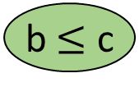
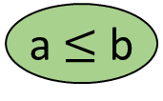

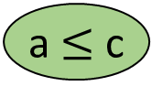

7.4 How Fast Can We Sort?
A sorting algorithm can be represented as a binary decision tree
Non-leaf node represents a comparison between two keys
Leaf nodes are the sorting results
[a, b, c]
a $≤$ b
Y
N
b $≤$ c
a $≤$ c
Y
N
Y
N
[a, b, c]
a $≤$c
[b, a, c]
b $≤$ c
Y
N
Y
N
[a, c, b]
[c, a, b]
[b, c, a]
[c, b, a]

Slide 36
How Fast Can We Sort?
Sorting n records:
Number of leaf nodes is at least n!
Tree height is at least (log(n!) + 1) = Ω(nlog(n))
→ sorting with worst time complexity < nlog(n) is impossible
Average root-to-leaf path length is Ω(nlog(n))
→ sorting with worst time complexity < nlog(n) is impossible
[a, b, c]
a $≤$ b
Y
N
b $≤$ c
a $≤$ c
Y
N
Y
N
[a, b, c]
a $≤$c
[b, a, c]
b $≤$ c
Y
N
Y
N
[a, c, b]
[c, a, b]
[b, c, a]
[c, b, a]

Slide 37
C++ STL sort Function
Quick sort.
Switch to heap sort when number of subdivisions exceeds some constant times log₂n.
Switch to insertion sort when segment size becomes small.
Quick Sort Complexity:
To improve performance, stop recursion when segment size is <= 15 (say) and sort these small segments using insertion sort.

Slide 38
Outline
7.1 Introduction
7.2 Insertion Sort
7.3 Quick Sort
7.4 How fast we can sort
7.5 Merge sort
7.6 Heap sort
7.7 Radix sort
7.8 (List and table sorts)
7.9 Summary of internal sorting

Slide 39
7.5 Merge Sort
1
2
3
4
5
6
5
2
6
1
4
3
Interpret the unsorted list as n sorted sublists, each of size 1
These lists are merged by pairs in each pass
Merge passes are continued until there is only one sublist remained
Merge Sort is stable
=
interpreted as n sublists
5
2
6
1
4
3
merge by pairs
2
5
1
6
3
4
merge by pairs
1
2
5
6
3
4
merge by pairs
1
2
3
4
5
6

Slide 40
Merge Sort Algorithm (Nonrecursive)
template <class T>
void MergeSort(T *a, const int n)
{ // sort a[1:n] into non-decreasing order
T *tempList = new T[n+1];
// s is the length of the currently merged sublist
for (int s = 1; s < n; s *= 2)
{
MergePass(a, tempList, n, s);
s *= 2;
MergePass(tempList, a, n, s);
}
delete [] tempList;
}
(to be continued)

Slide 41
Merge Sort Algorithm (Nonrecursive)
template <class T>
void MergePass(T *a, T *b, const int n, const int s)
{//adjacent pairs of sublist of size s are merged from a to b. n = # records in a
for (int i = 1; //i the first position in first of the sublists merged
i <= n-(2*s)+1; //enough elements for 2 sublists of length s?
i+ = 2*s) {
Merge(a, b, i, i+s-1, i+(2*s)-1);
}
// merge remaining lists of size < 2*s
if ((i + s-1) < n) //one full and one partial lists
Merge(a, b, i, i+s-1, n);
else //only one partial lists remained
copy(a+i, b+n+1, b+i);
}
(to be continued)

Slide 42
Merge Sort Algorithm (Nonrecursive)
template <class T>
void Merge(T *a, T *b, const int k, const int m, const int n)
{ // a[k:m], a[m+1:n] are sorted, merged to b[k:n]
for (int i1 = k, i2 = m+1, i3 = k;
i1 <= m && i2 <= n;
i3++) {
if (a[i1] <= a [i2]) {
b [i3] = a [i1];
i1++;
} else {
b [i3] = a [i2];
i2++;
}
}
// copy remaining records, if any, of 1st sublist
if(i2>n) copy (a+i1, a+m+1, b+i3);
// copy remaining records, if any, of 2nd sublist
if(i1>m)copy (a+i2, a+n+1, b+i3);
}
i1
i2
a
i3
merge
b

Slide 43
Nonrecursive Merge Sort
Input list is (26, 5, 77, 1, 61, 11, 59, 15, 48, 19). 10 keys.
Merge Tree

Slide 44
Nonrecursive Merge Sort
Input list has 13 keys.
[8]
[3]
[13]
[6]
[2]
[14]
[5]
[9]
[10]
[1]
[7]
[12]
[4]
[3, 8]
[6, 13]
[2, 14]
[5, 9]
[1, 10]
[7, 12]
[4]
[3, 6, 8, 13]
[2, 5, 9, 14]
[1, 7, 10, 12]
[4]
[2, 3, 5, 6, 8, 9, 13, 14]
[1, 4, 7, 10, 12]
[1, 2, 3, 4, 5, 6, 7, 8, 9, 10, 12, 13, 14]

Slide 45
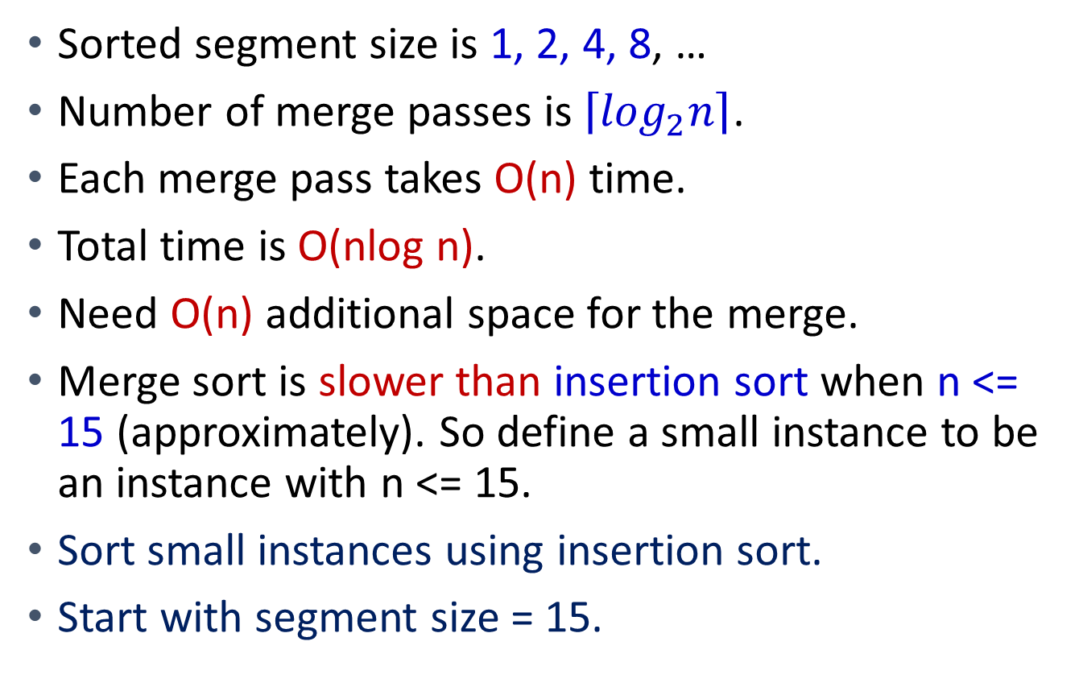
Complexity
Sorted segment size is 1, 2, 4, 8, …
Number of merge passes is $\left\lceil \log_{2}n\right\rceil$.
Each merge pass takes O(n) time.
Total time is O(nlog n).
Need O(n) additional space for the merge.
Merge sort is slower than insertion sort when n <= 15 (approximately). So define a small instance to be an instance with n <= 15.
Sort small instances using insertion sort.
Start with segment size = 15.

Slide 46
Merge Two Sorted Lists
A = (2, 5, 6)
B = (1, 3, 8, 9, 10)
C = ()
Compare smallest elements of A and B and merge smaller into C.
A = (2, 5, 6)
B = (3, 8, 9, 10)
C = (1)

Slide 47
Merge Two Sorted Lists
A = (5, 6)
B = (3, 8, 9, 10)
C = (1, 2)
A = (5, 6)
B = (8, 9, 10)
C = (1, 2, 3)
A = (6)
B = (8, 9, 10)
C = (1, 2, 3, 5)

Slide 48
Merge Two Sorted Lists
A = ()
B = (8, 9, 10)
C = (1, 2, 3, 5, 6)
When one of A and B becomes empty, append the other list to C.
A = ()
B = ()
C = (1, 2, 3, 5, 6, 8, 9, 10)
O(1) time needed to move an element into C.
Total time is O(n + m), where n and m are, respectively, the number of elements initially in A and B.

Slide 49
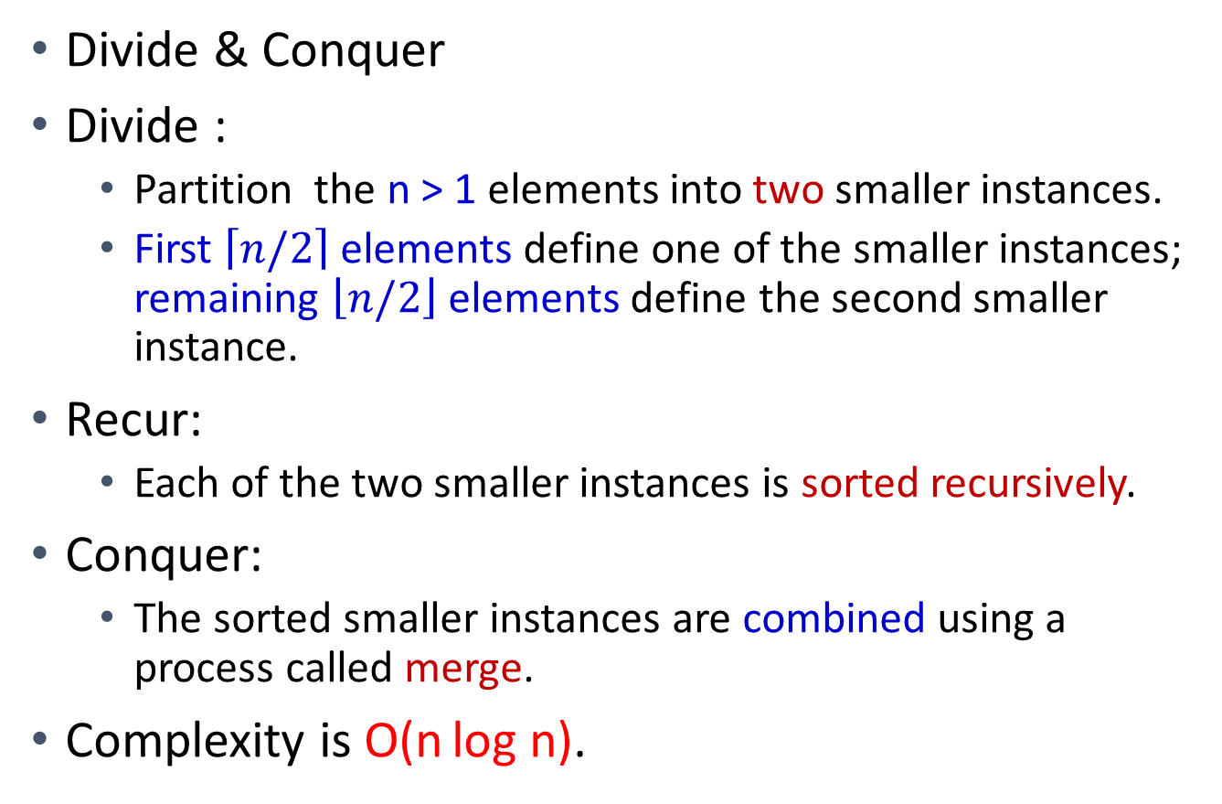
Recursive Merge Sort
Divide & Conquer
Divide :
Partition the n > 1 elements into two smaller instances.
First $\left\lceil n/2\right\rceil$ elements define one of the smaller instances; remaining $\left\lfloor n/2\right\rfloor$ elements define the second smaller instance.
Recur:
Each of the two smaller instances is sorted recursively.
Conquer:
The sorted smaller instances are combined using a process called merge.
Complexity is O(n log n).

Slide 50
Recursive Merge Sort
template <class T>
int rMergeSort(T* a, int* link, const int left, const int right)
{// 要排序的是a[left:right]。對於所有i，link[i] 初始化為0。
// rMerge回傳排序好的鏈的第一個元素之索引值。
if (left >= right) return left; //base case
int mid = (left + right) /2;
return ListMerge(a, link,
rMergeSort(a, link, left, mid), // 排序左半邊
rMergeSort(a, link, mid + 1, right));// 排序右半邊
}

Slide 51

Recursive Merge Sort
Input list is (26, 5, 77, 1, 61, 11, 59, 15, 48, 19). 10 keys.
Sublist partitioning for recursive merge sort
left
$$\left\lfloor (left+right)/2\right\rfloor$$
right

Slide 52
Recursive Merge Sort
Partition
[8, 3, 13, 6, 2, 14, 5, 9, 10, 1, 7, 12, 4]
[8, 3, 13, 6, 2, 14, 5]
[9, 10, 1, 7, 12, 4]
[8, 3, 13, 6]
[2, 14, 5]
[9, 10, 1]
[7, 12, 4]
[8, 3]
[13, 6]
[2, 14]
[5]
[9, 10]
[1]
[7, 12]
[4]
[8]
[3]
[13]
[6]
[2]
[14]
[9]
[10]
[7]
[12]

Slide 53
Recursive Merge Sort
To eliminate the record copying that takes pace when Merge() is used to merge sorted sublists, associate an integer pointer with each record.
For this purpose, employ an integer array link[1:n] such that link[i] gives the record that follows record i in the sorted sublist.
In case link[i] = 0, there is no next record.
Record copying is replaced by link changes and the run time of our sort function becomes independent of the size s of a record.
Iterative merge sort: O(snlogn) time, O(sn) extra space
Recursive merge sort: O(nlogn) time, O(n) extra space

Slide 54
Recursive Merge Sort
tamplate <class T>
int ListMerge(T* a, int* link, const int start1, const int start2)
{// 兩個排序好的鏈分別從start1及start2開始，將它們合併
// 將link[0]當作一個暫時的標頭。回傳合併好的鏈的開頭。
int iResult = 0; // 結果鏈的最後一筆記錄
for (int i1 = start1, i2 =start2; i1 && i2; )
if (a[i1] <= a[i2]) {
link[iResult] = i1;
iResult = i1; i1 = link[i1];}
else {
link[iResult] = i2;
iResult = i2; i2 =link[i2]; }
// 將其餘的記錄附接至結果鏈
if (i1 = = 0) link[iResult] = i2;
else link[iResult] = i1;
return link[0];
}

Slide 55
Recursive Merge Sort
Merge
[1, 2, 3, 4, 5, 6, 7, 8, 9, 10, 12, 13,14]
[2, 3, 5, 6, 8, 13, 14]
[1, 4, 7, 9, 10,12]
[3, 6, 8, 13]
[2, 5, 14]
[1, 9, 10]
[4, 7, 12]
[3, 8]
[6, 13]
[2, 14]
[5]
[9, 10]
[1]
[7, 12]
[4]
[8]
[3]
[13]
[6]
[2]
[14]
[9]
[10]
[7]
[12]

Slide 56
How Fast is Merge Sort ?
Both worst and average cases
log(n) merge passes are performed
Each merge pass is O(n)
Time complexity is O(nlog(n))

Slide 57
Variations of Merge Sort
Natural Merge Sort
Interpreting the initial list as multiple sorted sublists, each can contain more than one records
1
2
3
4
5
6
1
2
3
4
5
6
5
2
6
1
4
3
5
2
6
1
4
3
=
=
5
2
6
1
4
3
5
2
6
1
4
3
Original Implementation
Natural Merge Sort

Slide 58
C++ STL stable_sort Function
Merge sort is stable (relative order of elements with equal keys is not changed).
Quick sort is not stable.
STL’s stable_sort is a merge sort that switches to insertion sort when segment size is small

Slide 59
Outline
7.1 Introduction
7.2 Insertion Sort
7.3 Quick Sort
7.4 How fast we can sort
7.5 Merge sort
7.6 Heap sort
7.7 Radix sort
7.8 (List and table sorts)
7.9 Summary of internal sorting

Slide 60
7.6 Heap Sort Concept
1
2
3
4
5
6
7
8
6
3
8
1
5
4
2
7
Interpret the input list as a tree
Heapify the tree to form a max heap
Popping pass
Pop the top (maximum) record
Heap size shrinks by one
Space next to the heap becomes unused
Place the popped record at the space
Popping passes are continued until the heap becomes empty
Heap Sort is non-stable
=
interpreted as a tree
1
6
2
3
3
8
4
5
6
7
1
5
4
2
8
7
1
heapify the tree to form a max heap
8
2
3
7
6
4
5
6
7
3
5
4
2
8
1
1
2
3
4
5
6
7
8
8
7
6
3
5
4
2
1
convert the heap back to a list
1
2
3
4
5
6
7
8

Slide 61
Heap Sort Detail Steps
1
2
3
4
5
6
7
8
1
2
3
4
5
6
7
8
6
3
8
1
5
4
2
7
6
3
8
7
5
4
2
1
=
interpreted as a tree
1
1
6
6
2
3
2
3
3
8
3
8
4
5
6
7
4
5
6
7
1
5
4
2
7
5
4
2
8
8
heapify
7
1
heapify

Slide 62
Heap Sort Detail Steps
1
2
3
4
5
6
7
8
1
2
3
4
5
6
7
8
6
3
8
7
5
4
2
1
6
7
8
3
5
4
2
1
1
1
6
6
2
3
2
3
3
8
7
8
4
5
6
7
4
5
6
7
7
5
4
2
3
5
4
2
8
8
1
1
heapify
heapify

Slide 63
Heap Sort Detail Steps
heap
~ heap
1
2
3
4
5
6
7
8
1
2
3
4
5
6
7
8
8
7
6
3
5
4
2
1
1
7
6
3
5
4
2
8
1
1
8
1
2
3
2
3
7
6
7
6
4
5
6
7
4
5
6
7
3
5
4
2
3
5
4
2
8
8
heapify
(trickling down)
1
8

Slide 64
Heap Sort Detail Steps
heap
~ heap
1
2
3
4
5
6
7
8
1
2
3
4
5
6
7
8
7
5
6
3
1
4
2
8
2
5
6
3
1
4
7
8
1
1
7
2
2
3
2
3
5
6
5
6
4
5
6
7
4
5
6
7
3
1
4
2
3
1
4
7
8
8
heapify
(trickling down)
8
8

Slide 65
Heap Sort Detail Steps
heap
~heap
1
2
3
4
5
6
7
8
1
2
3
4
5
6
7
8
6
5
4
3
1
2
7
8
2
5
4
3
1
6
7
8
1
1
6
2
2
3
2
3
5
4
5
4
4
5
6
7
4
5
6
7
3
1
2
7
3
1
6
7
8
8
8
8

Slide 66
Heap Sort Algorithm
template <class T>
void HeapSort(T *a, const int n)
{// sort a[1..n] into non-decreasing order
// a[n/2] is the parent of the last node, a[n]
for (int i = n/2; i >= 1; i--) // buttom-up heapification
Adjust(a, i, n);// make the tree rooted at i be a max heap
for (int i = n-1; i >= 1; i--) {
swap(a[1], a[i+1]); // move one record from heap to list
Adjust(a, 1, i); // heapify
}
}
(to be continued)

Slide 67
Heap Sort Algorithm
template <class T>
void Adjust(T *a, const int root, const int n)
{
// two subtrees are max heaps already
// same procedure as the trickling-down procedure
T e = a[root];
//2*root is root's left child
for (int j = 2*root; j <= n; j *=2) {
if (j < n && a[j] < a[j+1]) // j and j+1 are siblings
j++; // make j be the max child
if (e >= a[j])
break;
a[j / 2] = a[j]; // move jth record up the path
}
a[j / 2] = e;
}

Slide 68
How Fast is Heap Sort?
Both worst and average cases
Heapifying the tree
n/2 adjust()’s are invoked, each is at most O(log(n))
Converting the max heap to the list
n pop()’s are invoked, each is at most O(log(n))
Overall, the time complexity is O(nlogn)

Slide 69
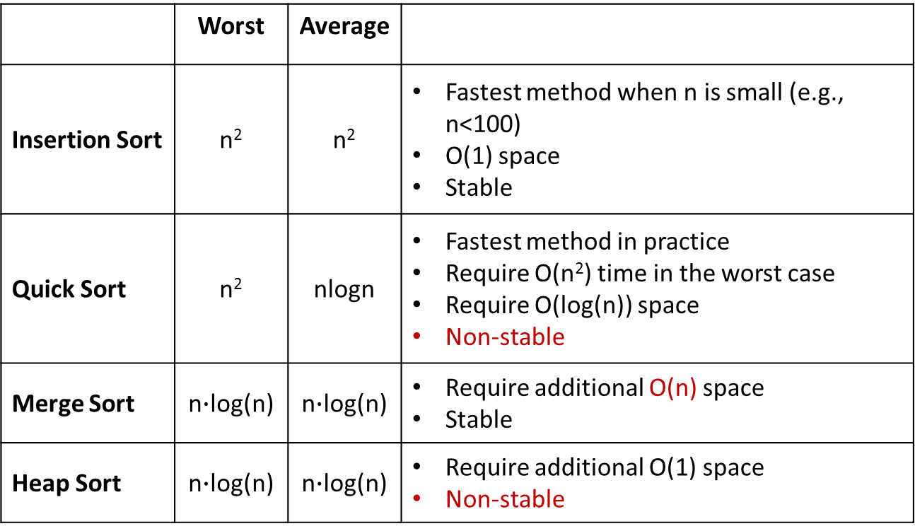
Summary
 | Worst | Average
Insertion Sort | n² | n² | Fastest method when n is small (e.g., n<100) O(1) space Stable
Quick Sort | n² | n∙logn | Fastest method in practice Require O(n²) time in the worst case Require O(log(n)) space Non-stable
Merge Sort |  |  | Require additional O(n) space Stable
Heap Sort |  |  | Require additional O(1) space Non-stable

Slide 70
Summary
Time
Number of elements to be sorted

Slide 71
Outline
7.1 Introduction
7.2 Insertion Sort
7.3 Quick Sort
7.4 How fast we can sort
7.5 Merge sort
7.6 Heap sort
7.7 Radix sort
7.8 (List and table sorts)
7.9 Summary of internal sorting

Slide 72
Bucket-Sort
Let be S be a sequence of n (key, element) items with keys in the range [0, N − 1]
Bucket-sort uses the keys as indices into an auxiliary array B of sequences (buckets)
Phase 1: Empty sequence S by moving each item (k, o) into its bucket B[k]
Phase 2: For i = 0, …, N − 1, move the items of bucket B[i] to the end of sequence S
Analysis:
Phase 1 takes O(n) time
Phase 2 takes O(n + N) time
Bucket-sort takes O(n + N) time

Slide 73
Algorithm bucketSort(S, N)
Input sequence S of (key, element) items with
keys in the range [0, N - 1] Output sequence S sorted by increasing keys
B ← array of N empty sequences
while !S.isEmpty()
f ← S.first()
(k, o) ← S.remove(f)
B[k].insertLast((k, o))
for i ← 0 to N - 1
while !B[i].isEmpty()
f ← B[i].first()
(k, o) ← B[i].remove(f)
S.insertLast((k, o)) //nondecreasing order

Slide 74
Example
Key range [0, 9]
7, d
1, c
3, a
7, g
3, b
7, e
Phase 1
1, c
3, a
3, b
7, d
7, g
7, e
B
0
1
2
3
4
5
6
7
8
9
∅
∅
∅
∅
∅
∅
∅
Phase 2
1, c
3, a
3, b
7, d
7, g
7, e

Slide 75
Properties and Extensions
Key-type Property
The keys are used as indices into an array and cannot be arbitrary objects
No external comparator
Stable Sort Property
The relative order of any two items with the same key is preserved after the execution of the algorithm
Extensions
Integer keys in the range [a, b]
Put item (k, o) into bucket B[k - a]
String keys from a set D of possible strings, where D has constant size (e.g., names of the 50 U.S. states)
Sort D and compute the rank r(k) of each string k of D in the sorted sequence
Put item (k, o) into bucket B[r(k)]

Slide 76
Lexicographic Order
A d-tuple is a sequence of d keys (k₁, k₂, …, k_{d}), where key k_{i} is said to be the i-th dimension of the tuple
Example:
The Cartesian coordinates of a point in space are a 3-tuple
The lexicographic order of two d-tuples is recursively defined as follows
(x₁, x₂, …, x_{d}) < (y₁, y₂, …, y_{d}) ⇔ x₁ < y₁ ∨ x₁ = y₁ ∧ (x₂, …, x_{d}) < (y₂, …, y_{d})
i.e., the tuples are compared by the first dimension, then by the second dimension, …, etc.

Slide 77
Lexicographic-Sort
Let C_{i} be the comparator that compares two tuples by their i-th dimension
Let stableSort(S, C) be a stable sorting algorithm that uses comparator C
Lexicographic-sort sorts a sequence of d-tuples in lexicographic order by executing d times algorithm stableSort, one per dimension
Lexicographic-sort runs in O(dT(n)) time, where T(n) is the running time of stableSort

Slide 78
Algorithm lexicographicSort(S)
Input sequence S of d-tuples Output sequence S sorted in lexicographic order
for i ← d downto 1
stableSort(S, C_{i})
Example:
(7, 4, 6) (5, 1, 5) (2, 4, 6) (2, 1, 4) (3, 2, 4)
(2, 1, 4) (3, 2, 4) (5, 1, 5) (7, 4, 6) (2, 4, 6)
(2, 1, 4) (5, 1, 5) (3, 2, 4) (7,4, 6) (2, 4, 6)
(2, 1, 4) (2, 4, 6) (3, 2, 4) (5, 1, 5) (7, 4, 6)

Slide 79
Basics of Sorting On Several Keys
Terminology
Keys: K¹, K², ..., K^{r}
K¹ is the most significant key
K^{r} is the least significant key
Comparison of multiple key (lexicographic order)
The r-tuple (x¹, x², ..., x^{r}) is less than or equal to the r-tuple (y¹, y², ..., y^{r}) iff either one of the following two conditions is satisfied
(1) x^{i}= y^{i} for 1≦i≦r, (=)
(2) x^{i}= y^{i} for 1≦i < α, and x^{α} < y^{α} for some 1≦α≦ r (<)
E.g., (1, 2, 3) < (1, 2, 5) → α = 3

Slide 80
Sorting on Several Keys
Sorting a deck of cards
Sort on two keys:
Suits K¹ (most-significant digit, MSD) :
♣ < ♦ < ♥ < ♠
Face values K² (least-significant digit, LSD) :
2 < 3 <… < Q < K < A
Two popular sorting strategies
MSD first sort
LSD first sort

Slide 81
Sorting on Several Keys
Two popular sorting strategies
MSD first sort
Sort the cards into 4 piles using K¹, one for each suit
Sort each of the 4 piles using K²
Cascade the sorted 4 piles with the order of (club, diamond, heart, spade):
2♣,…,A♣,2♦…,A♦,2♥……A♥,2♠,….A♠
LSD first sort
Sort the cards using K² into 13 piles
Then cascade the 13 piles into a big pile with the order of 2, 3, 4, ..., J, Q, K, A
Finally, sort the big pile using a stable sorting algorithm on the suit (K¹) into 4 piles, then combine:
2♣,…,A♣,2♦…,A♦,2♥……A♥,2♠,….A♠

Slide 82
Comparing MSD & LSD
LSD-first is simpler, as the piles and subpiles obtained do not have to be sorted independently (provided the sorting scheme used for sorting on the keys K^{i}, 1 ≤ i < r, is stable)
LSD-first sort is commonly chosen for computer sorting
MSD-first sort tends to incur more overhead because of the need to independently sort multiple groups:
First sorting on suit – bin sort into 4 bins
Then sorting on face – similar to insertion sort for each bin

Slide 83
Radix Sort
LSD or MSD sorting can be used to sort even when the records have only one key K.
Interpret the key as being composed of several subkeys, e.g., if 0 ≤ K ≤ 999 ⇒ K = (K¹, K², K³), 0 ≤ K^{i} ≤ 9
The sort on each K^{i} can be carried out using a bin sort with 10 bins.
In a Radix Sort, we decompose the sort key into several subkeys using some radix r
e.g., 365 is decomposed into 3, 6, and 5 with a radix = 10, so the number of bins required is 10.
Radix-sort is a specialization of lexicographic-sort that uses bucket-sort as the stable sorting algorithm in each dimension
Radix-sort runs in time O(d( n + N))

Slide 84
Radix Sort Example
Sorting a sequence of 4-bit integers (binary decomposition of key)
1001
0010
1001
1001
0001
0010
1110
1101
0001
0010
1101
1001
0001
0010
1001
0001
1101
0010
1101
1101
1110
0001
1110
1110
1110

Slide 85
LSD-First Radix Sort Example
Sort
Stable sort
Stable sort
105
290
105
105
342
540
540
193
555
342
342
290
290
193
555
342
540
105
290
540
193
555
193
555

Slide 86
Prog. 7.5 LSD Radix Sort
template <class T>
int RadixSort(T *a, int *link, const int d, const int r, const int n)
{
// 使用一個d位元、基數r的基數排序法來排序a[1:n]
// digit(a[i], j, r) 回傳a[i]的鍵值在第j個基數r的數字
//（從左邊）每一個數字的範圍都是[0, r)。
// 同一個數字內的排序使用容器排序法bin sort
int e[r], f[r]; // 佇列的頭以及尾巴指標
// 產生一個從first開始的記錄起始鏈
int first = 1;
for(int i=1; i<n; i++) link[i] = i + 1;// link into a chain
link[n] = 0;

Slide 87
for(i = d-1 ; i >=0; i--)
{// 根據數字i來排序
fill(f, f+r, 0); // 將容器初始化為空的佇列
for(int current=first;current;current= link[current])
{// 把記錄放到佇列/容器中
int k = digit(a[current], i , r);
if (f[k]== 0) f[k] = current;
else link[e[k]] = current;
e[k] =current;
}
for (j = 0; !f[j]; j++); // 找出第一個非空的佇列/容器
first = f[j];
int last = e[j];
for(int k = j + 1; k < r; k++) // 連接其餘的佇列
{
if(f[k]) { link[last] = f[k]; last = e[k]; }
}
link[last] = 0;
}
return first;
}

Slide 88
Example: Sorting 10 numbers in [0, 999], r=10, d=3

Slide 91
Outline
7.1 Introduction
7.2 Insertion Sort
7.3 Quick Sort
7.4 How fast we can sort
7.5 Merge sort
7.6 Heap sort
7.7 Radix sort
7.8 (List and table sorts)
7.9 Summary of internal sorting

Slide 92
Comparison of Sort Methods
Method | Worst | Average
Insertion Sort | n² | n²
Heap Sort | nlogn | nlogn
Merge Sort | nlogn | nlogn
Quick Sort | n² | nlogn

Slide 93
Comparison of Sort Methods
n | Insert | Heap | Merge | Quick
0 | 0.000 | 0.000 | 0.000 | 0.000
50 | 0.004 | 0.009 | 0.008 | 0.006
100 | 0.011 | 0.019 | 0.017 | 0.013
200 | 0.033 | 0.042 | 0.037 | 0.029
300 | 0.067 | 0.066 | 0.059 | 0.045
400 | 0.117 | 0.090 | 0.079 | 0.061
500 | 0.179 | 0.116 | 0.100 | 0.079
1000 | 0.662 | 0.245 | 0.213 | 0.169
2000 | 2.439 | 0.519 | 0.459 | 0.358
3000 | 5.390 | 0.809 | 0.721 | 0.560
4000 | 9.530 | 1.105 | 0.972 | 0.761
5000 | 15.935 | 1.410 | 1.271 | 0.970

Slide 94
Comparison of Sort Methods

Slide 95
Summary of Sorting Algorithms
Algorithm | Time (WC) | Time(Ave) | Notes
selection-sort | O(n²) | O(n²) | in-place slow (good for small inputs)
insertion-sort | O(n²) | O(n²) | in-place slow (good for small inputs)
quick-sort | O(n²) | O(n log n) expected | in-place, randomized fastest (good for large inputs)
heap-sort | O(n log n) | O(n log n) | in-place fast (good for large inputs)
merge-sort | O(n log n) | O(n log n) | sequential data access fast (good for huge inputs)

Slide 96
Summary
Every sorting algorithm has its pros and cons
No one size fit all solution
C++'s sort methods
sort()
Quick Sort that reverts to Heap Sort when the recursion depth exceeds some threshold and to Insertion Sort when the segment size becomes small
stable_sort()
Merge Sort that revers to Insertion Sort when the segment size becomes small
partial_sort()
Heap Sort that has ability to stop when only the first k elements need to be sorted

